Slide 1
Chapter 5: CPU Scheduling

Slide 2
Chapter 5: CPU Scheduling
Basic Concepts
Scheduling Criteria
Scheduling Algorithms
Multiple-Processor Scheduling
Real-Time Scheduling
Thread Scheduling
Operating Systems Examples
Java Thread Scheduling
Algorithm Evaluation

Slide 3
Basic Concepts
Maximum CPU utilization obtained with multiprogramming
CPU–I/O Burst Cycle – Process execution consists of a cycle of CPU execution and I/O wait
CPU burst distribution

Slide 4

Alternating Sequence of CPU And I/O Bursts

Slide 5

Histogram of CPU-burst Times

Slide 6
CPU Scheduler
Selects from among the processes in memory that are ready to execute, and allocates the CPU to one of them
CPU scheduling decisions may take place when a process:
  1. Switches from running to waiting state
  2. Switches from running to ready state
  3. Switches from waiting to ready
  4. Terminates
Scheduling under 1 and 4 is nonpreemptive
All other scheduling is preemptive

Slide 7
Dispatcher
Dispatcher module gives control of the CPU to the process selected by the short-term scheduler; this involves:
  switching context
  switching to user mode
  jumping to the proper location in the user program to restart that program
Dispatch latency – time it takes for the dispatcher to stop one process and start another running

Slide 8
Scheduling Criteria
CPU utilization – keep the CPU as busy as possible
Throughput – # of processes that complete their execution per time unit
Turnaround time – amount of time to execute a particular process
Waiting time – amount of time a process has been waiting in the ready queue
Response time – amount of time it takes from when a request was submitted until the first response is produced, not output (for time-sharing environment)

Slide 9
Optimization Criteria
Max CPU utilization
Max throughput
Min turnaround time
Min waiting time
Min response time

Slide 10
First-Come, First-Served (FCFS) Scheduling
Process Burst Time
P₁ 24
P₂ 3
P₃ 3
Suppose that the processes arrive in the order: P₁ , P₂ , P₃
The Gantt Chart for the schedule is:
Waiting time for P₁ = 0; P₂ = 24; P₃ = 27
Average waiting time: (0 + 24 + 27)/3 = 17
P₁
P₂
P₃
0
24
27
30

Slide 11
FCFS Scheduling (Cont.)
Suppose that the processes arrive in the order
P₂ , P₃ , P₁
The Gantt chart for the schedule is:
Waiting time for P₁ = 6; P₂ = 0; P₃ = 3
Average waiting time: (6 + 0 + 3)/3 = 3
Much better than previous case
Convoy effect short process behind long process
P₂
P₃
P₁
0
3
6
30

Slide 12
Shortest-Job-First (SJR) Scheduling
Associate with each process the length of its next CPU burst. Use these lengths to schedule the process with the shortest time
Two schemes:
  nonpreemptive – once CPU given to the process it cannot be preempted until completes its CPU burst
  preemptive – if a new process arrives with CPU burst length less than remaining time of current executing process, preempt. This scheme is know as the
  Shortest-Remaining-Time-First (SRTF)
SJF is optimal – gives minimum average waiting time for a given set of processes

Slide 13
Example of Non-Preemptive SJF
Process Arrival Time Burst Time
P₁ 0.0 7
P₂ 2.0 4
P₃ 4.0 1
P₄ 5.0 4
SJF (non-preemptive)
Average waiting time = (0 + 6 + 3 + 7)/4 = 4
P₁
P₃
P₂
P₄
0
3
7
8
12
16

Slide 14
Example of Preemptive SJF
Process Arrival Time Burst Time
P₁ 0.0 7
P₂ 2.0 4
P₃ 4.0 1
P₄ 5.0 4
SJF (preemptive)
Average waiting time = (9 + 1 + 0 +2)/4 = 3
P₁
P₂
P₃
P₂
P₄
P₁
0
2
4
5
7
11
16

Slide 15
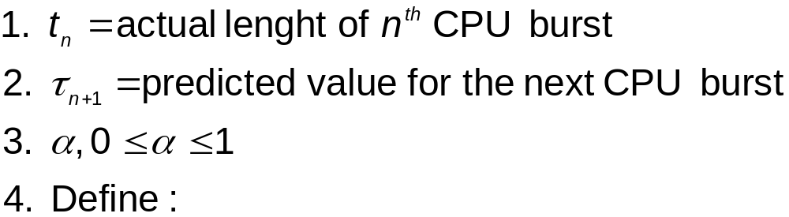

Determining Length of Next CPU Burst
Can only estimate the length
Can be done by using the length of previous CPU bursts, using exponential averaging

Slide 16

Prediction of the Length of the Next CPU Burst

Slide 17
Examples of Exponential Averaging
α =0
  τ_{n+1} = τ_{n}
  Recent history does not count
α =1
  τ_{n+1} = α t_{n}
  Only the actual last CPU burst counts
If we expand the formula, we get:
    τ_{n+1} = α t_{n}+(1 - α)α t_{n} ₋₁ + …
    +(1 - α )^{j} α t_{n} _{-j} + …
    +(1 - α )^{n +1} τ₀
Since both α and (1 - α) are less than or equal to 1, each successive term has less weight than its predecessor

Slide 18
Priority Scheduling
A priority number (integer) is associated with each process
The CPU is allocated to the process with the highest priority (smallest integer ≡ highest priority)
  Preemptive
  nonpreemptive
SJF is a priority scheduling where priority is the predicted next CPU burst time
Problem ≡ Starvation – low priority processes may never execute
Solution ≡ Aging – as time progresses increase the priority of the process

Slide 19
Round Robin (RR)
Each process gets a small unit of CPU time (time quantum), usually 10-100 milliseconds. After this time has elapsed, the process is preempted and added to the end of the ready queue.
If there are n processes in the ready queue and the time quantum is q, then each process gets 1/n of the CPU time in chunks of at most q time units at once. No process waits more than (n-1)q time units.
Performance
  q large ⇒ FIFO
  q small ⇒ q must be large with respect to context switch, otherwise overhead is too high

Slide 20
Example of RR with Time Quantum = 20
Process Burst Time
P₁ 53
P₂ 17
P₃ 68
P₄ 24
The Gantt chart is:
Typically, higher average turnaround than SJF, but better response
P₁
P₂
P₃
P₄
P₁
P₃
P₄
P₁
P₃
P₃
0
20
37
57
77
97
117
121
134
154
162

Slide 21

Time Quantum and Context Switch Time

Slide 22

Turnaround Time Varies With The Time Quantum

Slide 23
Multilevel Queue
Ready queue is partitioned into separate queues:
foreground (interactive)
background (batch)
Each queue has its own scheduling algorithm
  foreground – RR
  background – FCFS
Scheduling must be done between the queues
  Fixed priority scheduling; (i.e., serve all from foreground then from background). Possibility of starvation.
  Time slice – each queue gets a certain amount of CPU time which it can schedule amongst its processes; i.e., 80% to foreground in RR
  20% to background in FCFS

Slide 24

Multilevel Queue Scheduling

Slide 25
Multilevel Feedback Queue
A process can move between the various queues; aging can be implemented this way
Multilevel-feedback-queue scheduler defined by the following parameters:
  number of queues
  scheduling algorithms for each queue
  method used to determine when to upgrade a process
  method used to determine when to demote a process
  method used to determine which queue a process will enter when that process needs service

Slide 26
Example of Multilevel Feedback Queue
Three queues:
  Q₀ – FCFS with time quantum 8 milliseconds
  Q₁ – FCFS with time quantum 16 milliseconds
  Q₂ – FCFS
Scheduling
  A new job enters queue Q₀ which is served FCFS. When it gains CPU, job receives 8 milliseconds. If it does not finish in 8 milliseconds, job is moved to queue Q₁.
  At Q₁ job is again served FCFS and receives 16 additional milliseconds. If it still does not complete, it is preempted and moved to queue Q₂.

Slide 27

Multilevel Feedback Queues

Slide 28
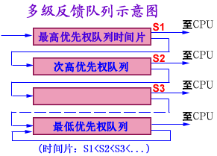

Slide 29
多级反馈队列算法
设置多个就绪队列，分别赋予不同的优先级，如逐级降低，队列1的优先级最高。每个队列执行时间片的长度也不同，规定优先级越低则时间片越长，如逐级加倍
新进程进入内存后，先投入队列1的末尾，按FCFS算法调度；若按队列1一个时间片未能执行完，则降低投入到队列2的末尾，同样按FCFS算法调度；如此下去，降低到最后的队列，则按"时间片轮转"算法调度直到完成。
仅当较高优先级的队列为空，才调度较低优先级的队列中的进程执行。如果进程执行时有新进程进入较高优先级的队列，则抢占执行新进程，并把被抢占的进程投入原队列的末尾。

Slide 30
多级反馈队列算法（续）
如果进程因请求I/O, 让出了CPU，那么在I/O完成后，进程将进入优先级比I/O请求时离开的队列高(一级)的队列中，而不是回到最高优先级队列（不然，若每次都回到最高优先级队列，那么以后可能需要再逐次下降到合适的队列）。

Slide 31
2. 几点说明
问题：一个进程创建时，首先进入最高优先级队列，然后按照下面原则提高或降低优先级：当I/O完成时，提高优先级；时间片用完时，降低优先级——这个做法照顾了I/O型进程，有助于适应进程在不同时间段的运行特点(I/O型或计算型)，为什么？优先级低的队列采用更大的时间片有什么好处？
I/O型进程的特点：CPU区间较小（一般就是一次I/O请求）。通常执行一个小时间片，就可处理完一次I/O请求的数据，然后转入到阻塞队列。由于进程开始就是进入最高优先级队列，所以I/O型进程的优先级能够始终具有最高级而获得照顾。
如果进程前半段是I/O型，后半段是计算型，那么前半段时间内进程具有较高的优先级；后半段当进程转为计算型时，其CPU区间变大，多个时间片才能完成，优先级逐步降低，适应计算型进程。相反，如果进程前半段是计算型，后半段是I/O型，那么进程在前半段逐步降低优先级，在后半段将逐级提高优先级。因而，可适应进程在不同时间段的特点。
如果进程进入到更低级队列，则进程的CPU区间较大，所以采用较大的时间片时可减少调度次数。
  对于计算型进程：每次都执行完时间片，进入更低级队列。最终采用最大时间片来执行，减少调度次数。

Slide 32
Multiple-Processor Scheduling
CPU scheduling more complex when multiple CPUs are available
Homogeneous processors within a multiprocessor
Load sharing
Asymmetric multiprocessing – only one processor accesses the system data structures, alleviating the need for data sharing

Slide 33
Real-Time Scheduling
Hard real-time systems – required to complete a critical task within a guaranteed amount of time
Soft real-time computing – requires that critical processes receive priority over less fortunate ones

Slide 34
Thread Scheduling
Local Scheduling – How the threads library decides which thread to put onto an available LWP
Global Scheduling – How the kernel decides which kernel thread to run next

Slide 35
Pthread Scheduling API
#include <pthread.h>
#include <stdio.h>
#define NUM THREADS 5
int main(int argc, char *argv[])
{
int i;
pthread t tid[NUM THREADS];
pthread attr t attr;
/* get the default attributes */
pthread attr init(&attr);
/* set the scheduling algorithm to PROCESS or SYSTEM */
pthread attr setscope(&attr, PTHREAD SCOPE SYSTEM);
/* set the scheduling policy - FIFO, RT, or OTHER */
pthread attr setschedpolicy(&attr, SCHED OTHER);
/* create the threads */
for (i = 0; i < NUM THREADS; i++)
pthread create(&tid[i],&attr,runner,NULL);

Slide 36
Pthread Scheduling API
/* now join on each thread */
for (i = 0; i < NUM THREADS; i++)
pthread join(tid[i], NULL);
}
/* Each thread will begin control in this function */
void *runner(void *param)
{
printf("I am a thread\n");
pthread exit(0);
}

Slide 37
Operating System Examples
Solaris scheduling
Windows XP scheduling
Linux scheduling

Slide 38
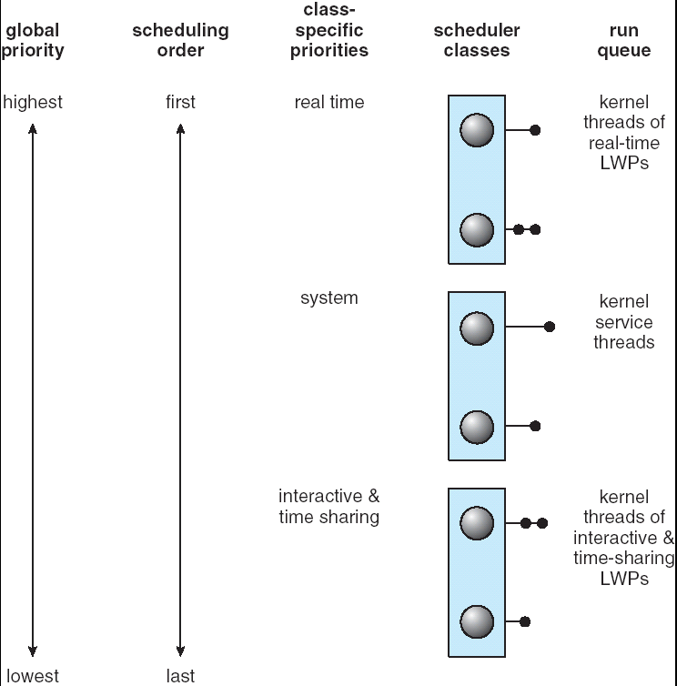
Solaris 2 Scheduling

Slide 39

Solaris Dispatch Table

Slide 40

Windows XP Priorities

Slide 41
Linux Scheduling
Two algorithms: time-sharing and real-time
Time-sharing
  Prioritized credit-based – process with most credits is scheduled next
  Credit subtracted when timer interrupt occurs
  When credit = 0, another process chosen
  When all processes have credit = 0, recrediting occurs
    Based on factors including priority and history
Real-time
  Soft real-time
  Posix.1b compliant – two classes
    FCFS and RR
    Highest priority process always runs first

Slide 42

The Relationship Between Priorities and Time-slice length

Slide 43

List of Tasks Indexed According to Prorities

Slide 44
Algorithm Evaluation
Deterministic modeling – takes a particular predetermined workload and defines the performance of each algorithm for that workload
Queueing models
Implementation

Slide 45

5.15

Slide 46
End of Chapter 5

Slide 47
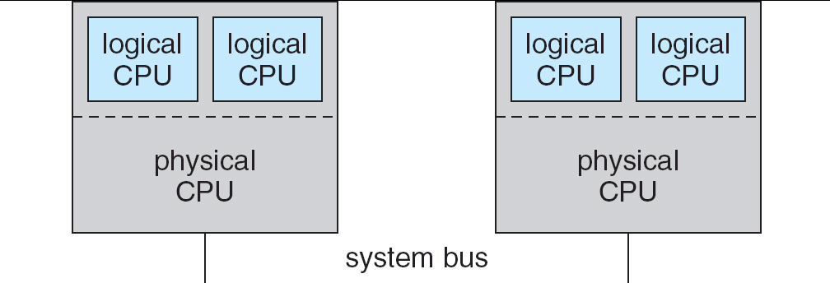
5.08

Slide 48

In-5.7

Slide 49
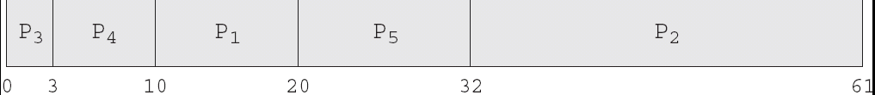
In-5.8

Slide 50

In-5.9

Slide 51

Dispatch Latency

Slide 52
Java Thread Scheduling
JVM Uses a Preemptive, Priority-Based Scheduling Algorithm
FIFO Queue is Used if There Are Multiple Threads With the Same Priority

Slide 53
Java Thread Scheduling (cont)
JVM Schedules a Thread to Run When:
  The Currently Running Thread Exits the Runnable State
  A Higher Priority Thread Enters the Runnable State
* Note – the JVM Does Not Specify Whether Threads are Time-Sliced or Not

Slide 54
Time-Slicing
Since the JVM Doesn’t Ensure Time-Slicing, the yield() Method
May Be Used:
while (true) {
// perform CPU-intensive task
. . .
Thread.yield();
}
This Yields Control to Another Thread of Equal Priority

Slide 55
Thread Priorities
Priority Comment
Thread.MIN_PRIORITY Minimum Thread Priority
Thread.MAX_PRIORITY Maximum Thread Priority
Thread.NORM_PRIORITY Default Thread Priority
Priorities May Be Set Using setPriority() method:
setPriority(Thread.NORM_PRIORITY + 2);

